Slide 1

Java Programming II
User-Defined Classes and ADTs

Slide 2
Chapter Objectives
Learn about classes
Learn about private, protected, public, and static members of a class
Explore how classes are implemented
Learn about the various operations on classes

Slide 3
Chapter Objectives (continued)
Examine constructors and finalizers
Examine the method toString
Learn about the abstract data type (ADT)

Slide 4
Classes
final class String
{
//variables to store a string
...
public int compareTo(String anotherString)
{
//code to compare two strings
}
public String concat(String str)
{
//code to join two strings
}
public String toLowerCase()
{
//code to convert all the characters of a
//string to lowercase
}
...
}

Slide 5
Classes (continued)
class: reserved word; collection of a fixed number of components
Components: members of a class
Members accessed by name
Class categories/modifiers
private
protected
public

Slide 6
Classes (continued)
private: members of class are not accessible outside class
public: members of class are accessible outside class
Class members: can be methods or variables
Variable members declared like any other variables

Slide 7
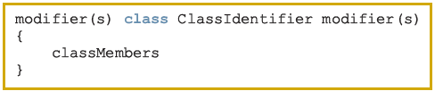
Syntax
The general syntax for defining a class is:

Slide 8
Syntax (continued)
If a member of a class is a named constant, you declare it just like any other named constant
If a member of a class is a variable, you declare it just like any other variable
If a member of a class is a method, you define it just like any other method

Slide 9
Syntax (continued)
If a member of a class is a method, it can (directly) access any member of the class—data members and methods
- Therefore, when you write the definition of a method (of the class), you can directly access any data member of the class (without passing it as a parameter)

Slide 10
class Clock
Data Members (Instance Variables)
private int hr; //store hours
private int min; //store minutes
private int sec; //store seconds

Slide 11
class Clock (continued)
Methods
public void setTime(int hours,
int minutes, int seconds)
public int getHours()
public int getMinutes()
public int getSeconds()
public void printTime()
public void incrementSeconds()
public void incrementMinutes()
public void incrementHours()
public boolean equals(Clock otherClock)
public void makeCopy(Clock otherClock)
public Clock getCopy()

Slide 12
Constructors
Two types of constructors
- With parameters
- Without parameters (default constructor)

Slide 13
Constructors (continued)
Constructors have the following properties:
- The name of a constructor is the same as the name of the class
- A constructor, even though it is a method, has no type
- A class can have more than one constructor; all constructors of a class have the same name
- If a class has more than one constructor, any two constructors must have different signatures
- Constructors are automatically executed when a class object is instantiated
- If there are multiple constructors, which constructor executes depends on the type of values passed to the class object when the class object is instantiated

Slide 14
class Clock: Constructors
Default constructor is:
- public Clock()
Constructor with parameters is:
- public Clock(int hours, int minutes, int seconds)

Slide 15
Unified Modeling Language Class Diagrams

Slide 16

Variable Declaration and Object Instantiation
The general syntax for using the operator new is:
or:
Clock myClock;
Clock yourClock;
myClock = new Clock();
yourClock = new Clock(9, 35, 15);

Slide 17
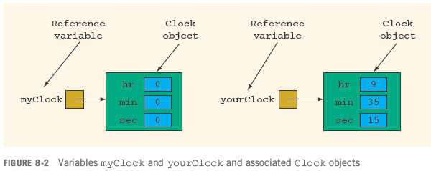
Variable Declaration and Object Instantiation (continued)

Slide 18
Variable Declaration and Object Instantiation (continued)

Slide 19

Accessing Class Members
The syntax to access a data member of a class object or method is:
Example 8-1
myClock.setTime(5, 2, 30);
myClock.printTime();
yourClock.setTime(x, y, z);
if (myClock.equals(yourClock))
.
.
.

Slide 20
Assignment Operator: A Precaution
myClock = yourClock;
Copies the value of the reference variable yourClock into the reference variable myClock
- After this statement executes, both yourClock and myClock refer to the same object

Slide 21
Assignment Operator: A Precaution (continued)
Shallow copying: two or more reference variables of the same type point to the same object
Deep copying: each reference variable refers to its own object

Slide 22
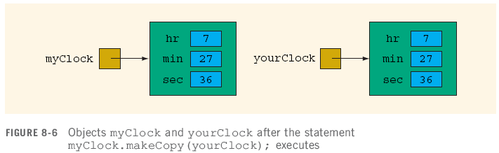
Assignment Operator: A Precaution (continued)

Slide 23
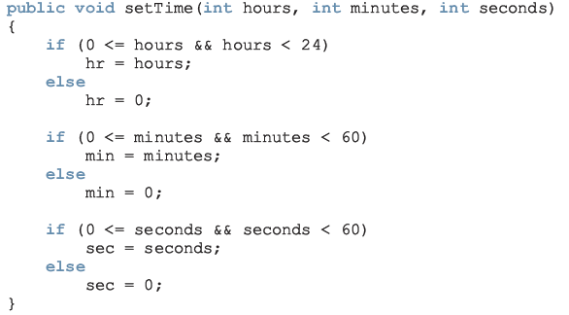
Definitions of the Constructors and Methods of the class Clock

Slide 24
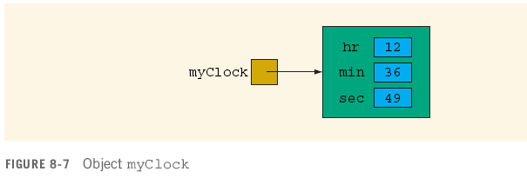
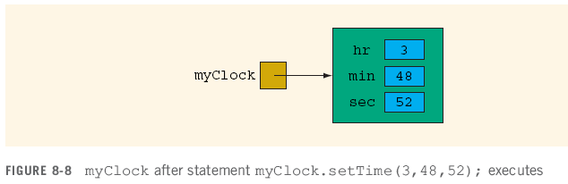
Definitions of the Constructors and Methods of the class Clock (continued)

Slide 25
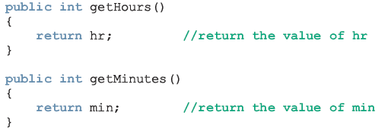

Definitions of the Constructors and Methods of the class Clock (continued)

Slide 26
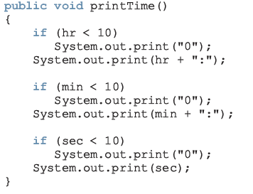
Definitions of the Constructors and Methods of the class Clock (continued)

Slide 27
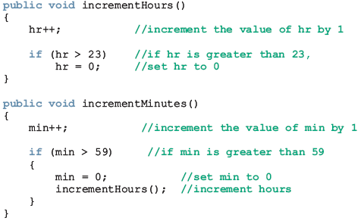
Definitions of the Constructors and Methods of the class Clock (continued)

Slide 28
Definitions of the Constructors and Methods of the class Clock (continued)

Slide 29
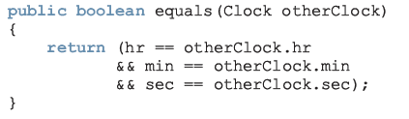
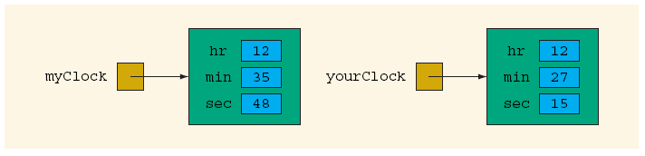
Definitions of the Constructors and Methods of the class Clock (continued)

Slide 30

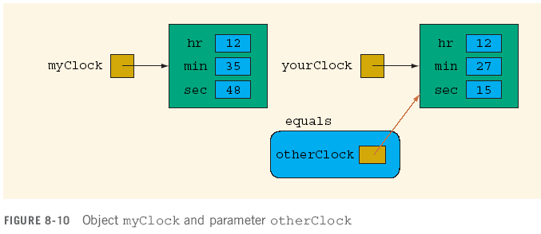
Definitions of the Constructors and Methods of the class Clock (continued)

Slide 31
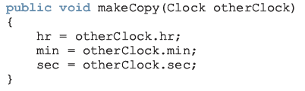
Definitions of the Constructors and Methods of the class Clock (continued)

Slide 32
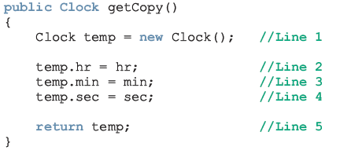
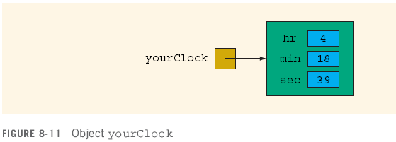
Definitions of the Constructors and Methods of the class Clock (continued)

Slide 33
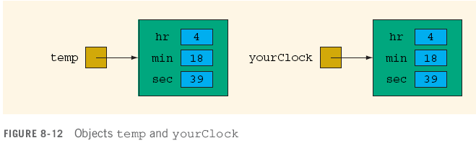
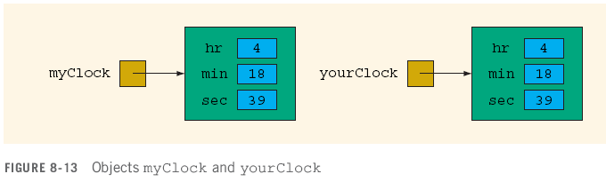
Definitions of the Constructors and Methods of the class Clock (continued)

Slide 34
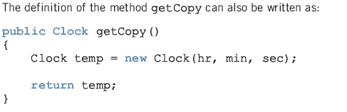
Definitions of the Constructors and Methods of the class Clock (continued)

Slide 35
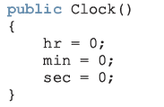

Default Constructor
or

Slide 36
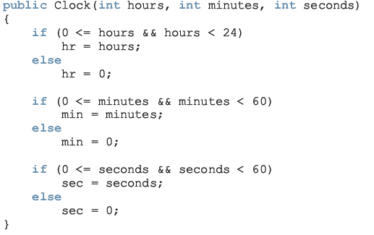

Constructor with Parameters
or

Slide 38
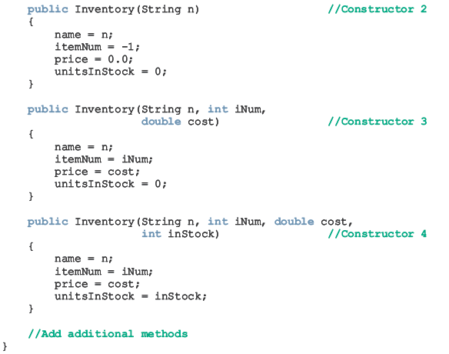

Slide 41
The Method toString
public value-returning method
Takes no parameters
Returns address of a String object
Output using print, println, printf methods
Default definition creates String with name of object’s class name followed by hash code of object

Slide 42
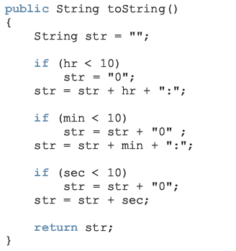
Method toString: class Clock

Slide 43

The Copy Constructor
Executes when an object is instantiated
Initialized using an existing object
Syntax

Slide 44
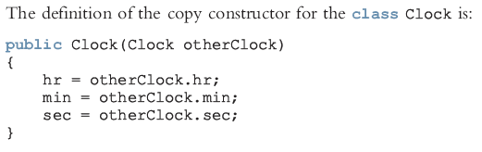
The Copy Constructor (continued)

Slide 45
The Modifier static
In the method heading, it specifies that the method can be invoked by using the name of the class
If used to declare data member, data member invoked by using the class name
Static data members of class exist even when no object of class type is instantiated
Static variables are initialized to their default values

Slide 46
Static Members of a Class
Example 8-5
public class Illustrate
{
private int x;
private static int y;
public static int count;
public Illustrate()
{
x = 0;
}
public Illustrate(int a)
{
x = a;
}

Slide 47
Static Members of a Class (continued)
void setX(int a)
{
x = a;
}
public String toString()
{
return("x = " + x + ", y = " + y
+ ", count = " + count);
}
public static void incrementY()
{
y++;
}
}
Illustrate illusObject = new Illustrate();
Illustrate.incrementY();
Illustrate.count++;

Slide 48
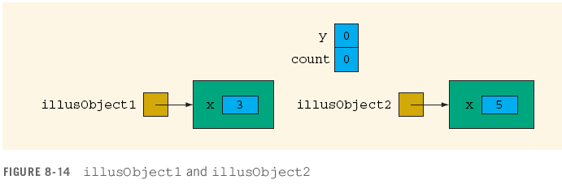
Static Members of a Class (continued)
Illustrate illusObject1 = new Illustrate(3);
Illustrate illusObject2 = new Illustrate(5);

Slide 49
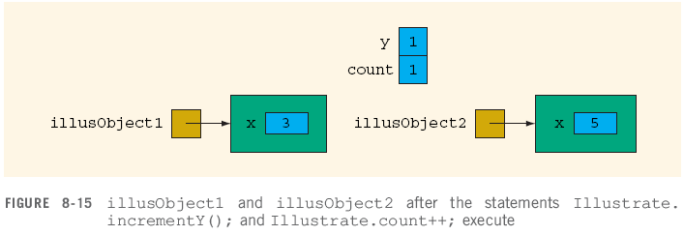
Static Members of a Class (continued)
Illustrate.incrementY();
Illustrate.count++;

Slide 50
Finalizers
Automatically execute when class object goes out of scope
Have no parameters
Only one finalizer per class
Name of finalizer: finalize

Slide 51
Accessor and Mutator Methods
Accessor Method: a method of a class that only accesses (that is, does not modify) the value(s) of the data member(s)
Mutator Method: a method of a class that modifies the value of one or more data member(s)

Slide 52
Before moving to the design phase, a problem must be thoroughly understood so that the focus is on solving the problem.
Once a class is designed, it must be properly documented.
In order to design the class Clock, first we identified the operations and determined that each operation must be implemented using a method.
We then identified the data members and their types.
We also identified which member should be public and which should be private.
An algorithm must be designed and documented to implement a method.
Describing the algorithm is not as important as the clarity of the algorithm.

Slide 54


Slide 55
You can write the Java code of the class Clock using this specification.
You can also specify the design of a class as it is shown in the programming example, Candy Machine, of this chapter.
To become an effective and a good programmer, you must avoid the temptation to skip the design phase.
It is possible that the first few programs that you write can be coded directly.
In general, this approach works only for very small programs.
You will spend less time in implementing, debugging, and maintaining a code that is properly designed and documented.

Slide 56
The Reference this
Refers to instance variables and methods of a class
Used to implement cascaded method calls

Slide 57
Inner Classes
Defined within other classes
Can be either a complete class definition or anonymous inner class definition
Used to handle events

Slide 58
Abstract Data Types
Definition
- A data type that specifies the logical properties without the implementation details

Slide 59
Programming Example: Candy Machine (Problem Statement)
A new candy machine is bought for the gym, but it is not working properly
-The machine sells candies, chips, gum, and cookies
Write a two-part program to create a Java application program for this candy machine so that it can be put into operation
- In the first part, design a non-GUI application program
- In the second part, design an application program that will create a GUI as described in the second part

Slide 60
Programming Example: Candy Machine (Problem Statement) (continued)
The non-GUI application program should do the following:
1. Show the customer the different products sold by the candy machine
2. Let the customer make the selection
3. Show the customer the cost of the item selected
4. Accept money from the customer
5. Release the item

Slide 61
Programming Example: Candy Machine (Input and Output)
Input: the item selection and the cost of the item
Output: the selected item

Slide 62
Programming Example: Candy Machine
Components
Cash register
Dispenser
Machine

Slide 63
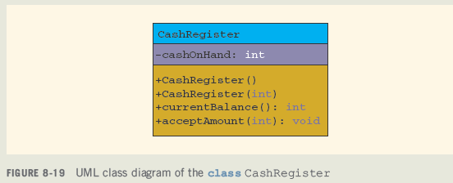
Programming Example: Candy Machine (continued)

Slide 64
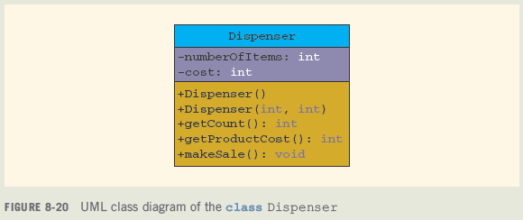
Programming Example: Candy Machine (continued)

Slide 65
Programming Example: Candy Machine (continued)

Slide 66
Programming Example: Candy Machine (continued)

Slide 67
Programming Example: Candy Machine (continued)

Slide 68
Programming Example: Candy Machine (continued)

Slide 69
Chapter Summary
Creating classes
Members of a class
private
protected
public
static
Implementing classes
Various operations on classes

Slide 70
Chapter Summary (continued)
Constructors
Finalizers
Method toString
Abstract data types

